Slide 1

Intro to AI DEVELOPMENT
Team-
Sonakshi karkera
Arun Kalaeswaran
Surbhi ThaKUr
Rahul Angalakduti

Slide 2
CONTENT
Problem Statement
Data Source/ Exploratory Data Analysis
Distribution of Features/Target Variable
Implementing Machine Learning Algorithms
Best Algorithm
Challenges & Future Improvements

Slide 3

Problem statement
To predict the Sales Price of the house by implementing Machine Learning algorithms on dataset provided by Kaggle.
Different Type of people tend to have different priorities for buying the house and are interested in different attributes. The final price of the house depends on numerous features and to predict the price of house is one of the difficult tasks.

Slide 4
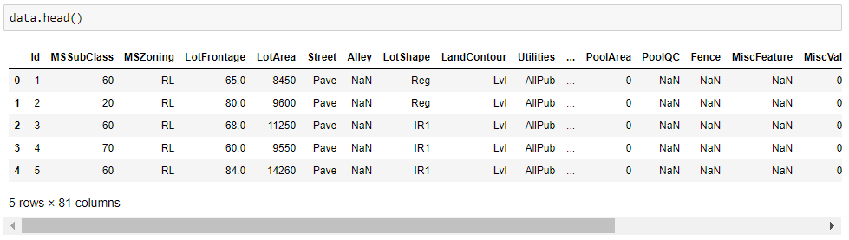
Data Source
The dataset ‘Ames Housing Prices’ was provided by Kaggle for House Pricing Prediction Competition.
The rows and columns present in train file is 1460,81 and in test file is 1459,80
There are total 79 features present in the dataset using which we will implement the price prediction model.

Slide 5

Data Source- Tools and Libraries used
Pandas/NumPy- Data Storage and Organization
Matplotlib/ Seaborn – To implement graphs and visualizations on the data analysis
Sklearn- To implement the machine learning algorithms and measuring their accuracy score.

Slide 6
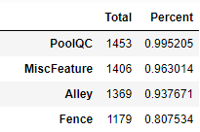
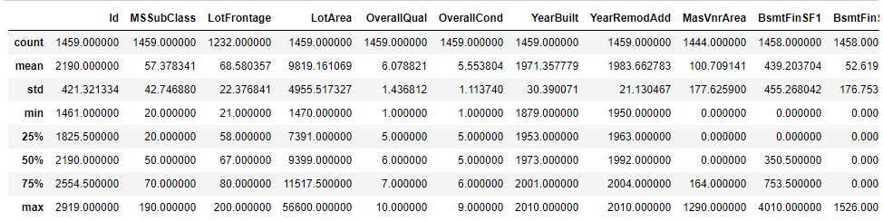
Exploratory Data analysis
Determining Features and Target variable.
Summary of dataset-This gives us important information about count, min, max, std, mean and percentile for each feature
Handling Missing values-
Removing Columns having more than 50% of missing data.
Imputing NA’ of categorical variable with None
Filling Null values with the mean of the feature.
One Hot Encoder- To convert string values to categorical values

Slide 7
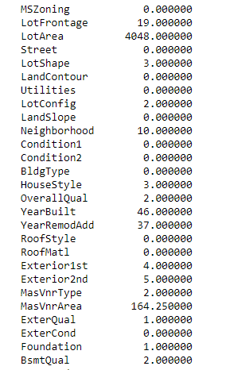
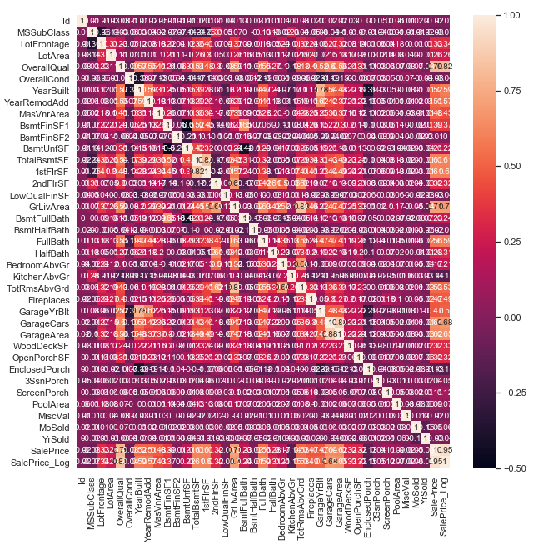
Eda contd.
Handling Collinearity:
Dropping features that are not strongly correlated.
Outlier Detection-Dropping rows which are less than 25% and more than 75% of the mean value of the feature
Normalization of data

Slide 8
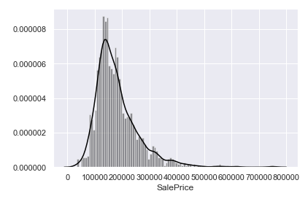
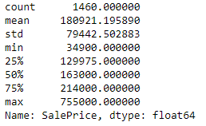
Distribution of target variable

Slide 9
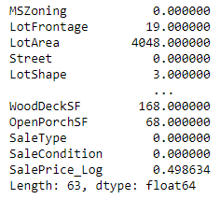
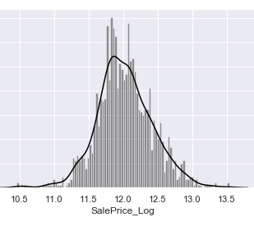
Log Transformation/ Outlier detection
The target price distribution is skewed to right and there are some outliers lies above 500,000 hence SalePrice is not normally distributed. This can reduce the performance of model therefore we use the log transformation

Slide 10
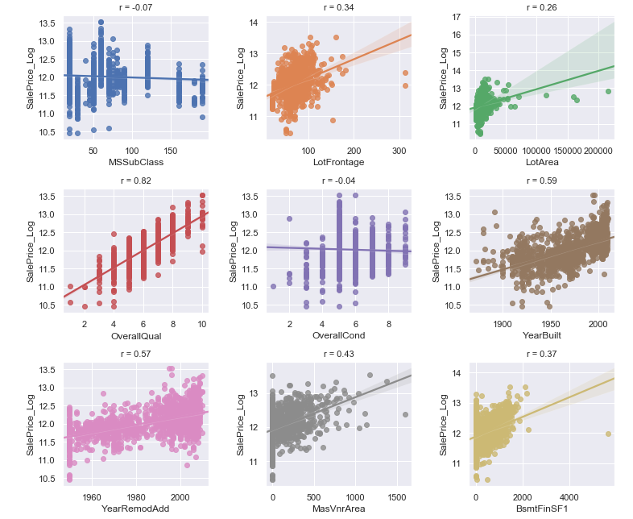
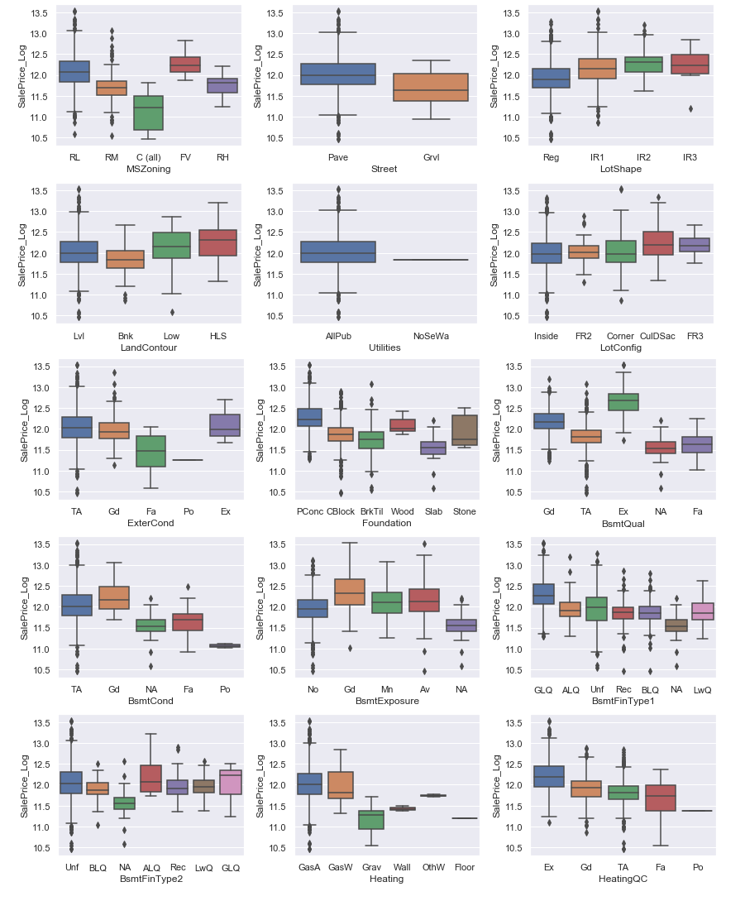
Distribution of Features/Target
Correlation of numerical features/Target
Correlation of categorical variables/Target

Slide 11
Implementing Machine learning algorithm
Linear Regression
KNN Regressor
Decision Tree
Gradient Boost

Slide 12
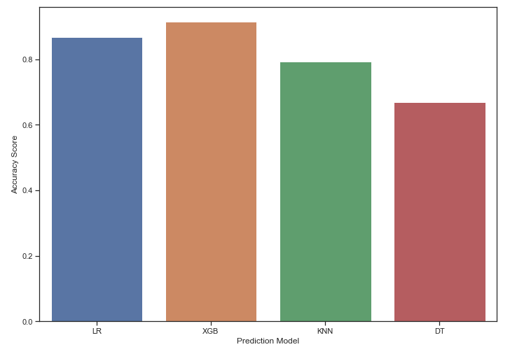
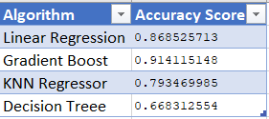
BEST ALGORITHM
We implemented the algorithm’s and compare their accuracy score and the Gradient Boost has the maximum accuracy and Decision Tree with the least accuracy.

Slide 13
Why Gradient Boost Gives the best prediction?
Gradient Boost works best with Numerical and Categorical Data
This algorithm can optimize on different loss functions and provides several parameter tuning options that make the function fit very flexible

Slide 14
challenges
Dealing with the categorical and numerical data.
01
Feature Engineering based on correlation
02

Slide 15
CONCLUSION/ FUTURE IMPROVEMENTS
As conclusion, XGBoost algorithm gave us the best results with accuracy of 91%.
FUTURE IMPROVEMENTS
Working on Feature Extraction using PCA.
Working on all the outliers
Additional Data as we only have 1460 data.
Using more optimizing Methods.

Slide 16
THANK YOU Questions or Comments?

